Slide 1
Hi, everyone. All are safe at home which is utmost essential. Let us make use of this time and start studies for coming year through presentations.
We will start with Photosynthesis, the basics you know from std.7. We will deal with some simple concepts through presentation and some concepts will be done in the classroom when we meet.

Slide 2
Photosynthesis
Photosynthesis is the process by which living plant cells, Containing chlorophyll, produce food substances (glucose and starch), from carbon dioxide and water, by using light energy. Plants release oxygen as by-product during the process.
The capture of light energy to make carbohydrate from carbon dioxide and water

Slide 3
Photosynthetic Organisms
Plants
Algae
Cyanobacteria
Overview of Photosynthesis
6 H₂O + 6 CO₂ ==> C₆H₁₂O₆ + 6 O₂
water + carbon dioxide ==>
sugar + oxygen

Slide 4
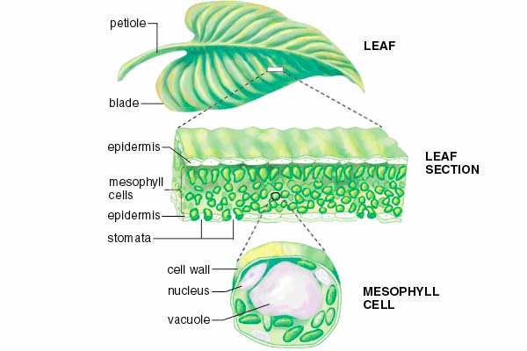
Cross section of LEAF

Slide 5
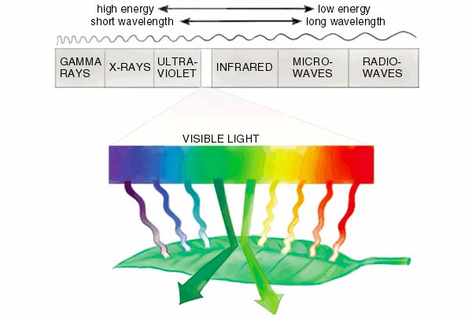
Why is Chlorophyll Green in colour

Slide 6
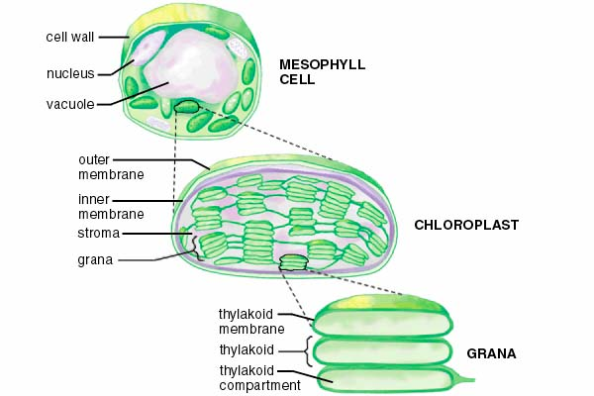
Internal Structure of Chloroplast

Slide 7
Significance of Photosynthesis
Food and oxygen for all living organisms
Plants are autotrophs.
Homework;
Give reasons:
Tiger owes its existence to the plants
Plants form the baseline of food-chain.
Self study topics-Read and understand.
Adaptations in leaf to perform photosynthesis
End result of the products of photosynthesis.
Factors affecting photosynthesis.
Carbon cycle.

Slide 8
Experiments on photosynthesis
Open the following links and study the
experiments
https://www.youtube.com/watch?v=Yqo6-qDQoMA
https://www.youtube.com/watch?v=lji6Zx3_E30
https://www.youtube.com/watch?v=fYlWiNs3qFM
https://www.youAAtube.com/watch?v=0s_xZqvwm_s

Slide 9
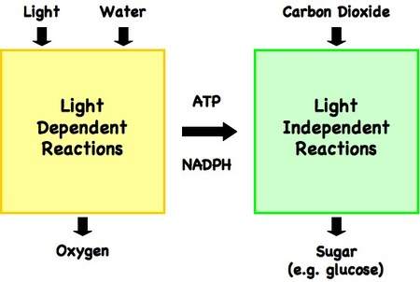
Process of Photosynthesis
Light dependent phase
Step-1-Activation of chlorophyll-photons activate chlorophyll
Step-2-Splitting of water-Water molecule is split into two components hydrogen and oxygen
End results of the products of photolysis
The oxygen component given as molecular oxygen O2
The hydrogen ions are picked up by a compound NADP to NADPH.
Electrons are used to convert ADP to ATP

Slide 10
Home work
Concise Copy 2020 Page Number 78-81
Review Questions;
A. Multiple Choice Type( on text book with pencil)
B. Very Short Answer Type (on text book with pencil)
C. Short Answer type-1.Difference (notebook)
C. 2,3,4,5,13,16 ( on text book with pencil)
D. Structured Questions;
1,3,4,6,8,9 try to answer with pencil in the textbook and then check the answer given at the end of presentation.

Slide 11
Home work Continued
Draw the following diagrams in the notebook
A chloroplast .Fig. 6.1
The opening and closing of stomata.Fig.6.2
Complete the given work In next seven days. I will post you the details of how to check your answers after few days.
Students do your work sincerely on your own before you check the answers after few days.
The concepts if not understood will be explained in regular classes.

